Slide 1
instructions FOR THE USER OF PROXY

Slide 2
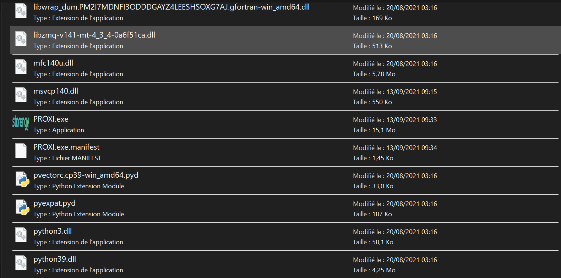
Launch PROXI.exe

Slide 3
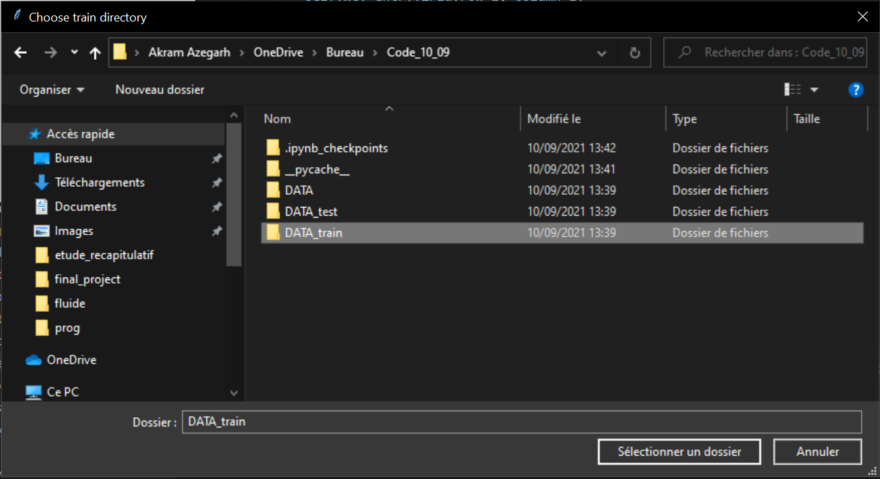
1) SELECT DATA FOLDER THAT CONTAINS .xlsx FILES USED FOR TRAIN

Slide 4
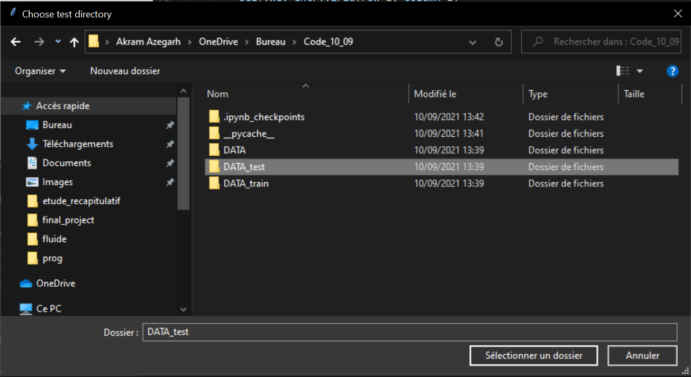
2) SELECT DATA FOLDER THAT CONTAINS .xlsx FILES USED FOR TEST

Slide 5
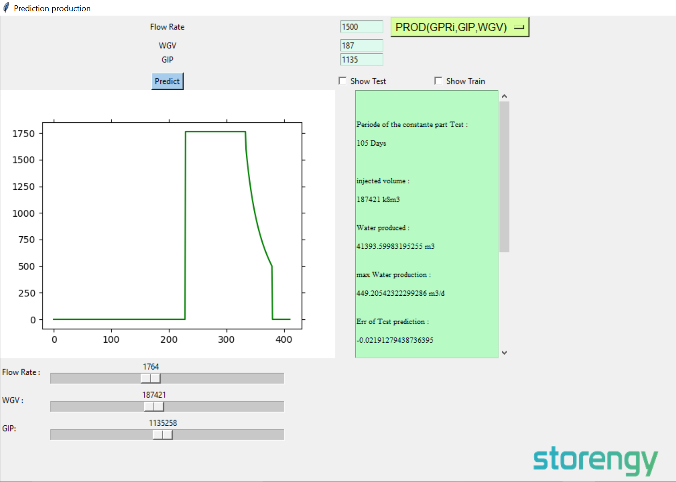
INFORMATION ABOUT THE PREDICTED CURVE AND THE ERROR MADE BY THE MODEL IN THE TEST
PARAMETERS OF THE PREDICTION

Slide 6
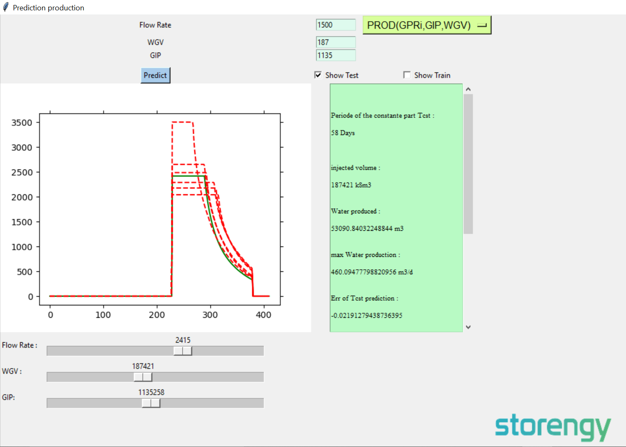
DISPLAY TRAIN/TEST CURVES

Slide 7
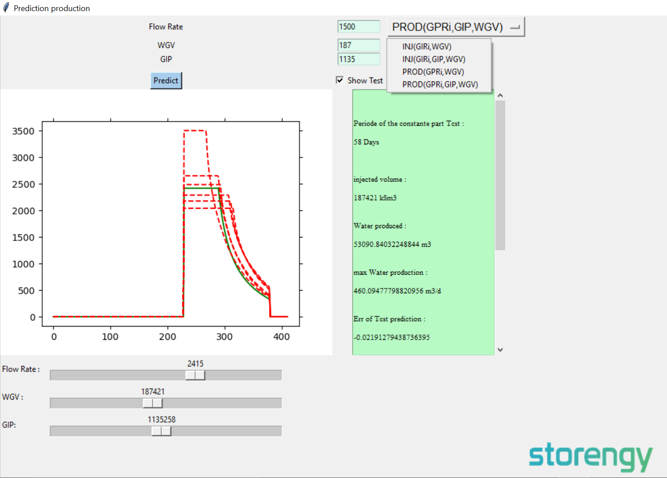
CHANGE
THE PREDICTION
MODEL

